Slide 1
HTML (PART – 3)
Forms

Slide 2
Forms
A form is the usual way information is gotten from a browser to a server
HTML has tags to create a collection of objects that implement this information gathering
The objects are called widgets (e.g., radio buttons and checkboxes)
When the Submit button of a form is clicked, the form’s values are sent to the server
All of the widgets, or components of a form are defined in the content of a <form> tag
The only required attribute of <form> is action, which specifies the URL of the application that is to be called when the Submit button is clicked
action =
"http://www.cs.ucp.edu/cgi-bin/survey.pl"
If the form has no action, the value of action is the empty string

Slide 3
Forms (continued)
The method attribute of <form> specifies one of the two possible techniques of transferring the form data to the server, get and post
get and post are discussed in Chapter 10
Widgets
Many are created with the <input> tag
The type attribute of <input> specifies the kind of widget being created
Text
Creates a horizontal box for text input
Default size is 20; it can be changed with the size attribute
If more characters are entered than will fit, the box is scrolled (shifted) left

Slide 4
Forms (continued)
If you don’t want to allow the user to type more characters than will fit, set maxlength, which causes excess input to be ignored
<input type = "text" name = "Phone"
size = "12" >
2. Checkboxes - to collect multiple choice input
Every checkbox requires a value attribute, which is the widget’s value in the form data when the checkbox is ‘checked’
A checkbox that is not ‘checked’ contributes no value to the form data
By default, no checkbox is initially ‘checked’
To initialize a checkbox to ‘checked’, the checked attribute must be set to "checked"

Slide 5
Forms (continued)
Widgets (continued)
Grocery Checklist
<form action = "">
<p>
<input type = "checkbox" name ="groceries"
value = "milk" checked = "checked">
Milk
<input type = "checkbox" name ="groceries"
value = "bread">
Bread
<input type = "checkbox" name = "groceries"
value= "eggs">
Eggs
</p>
</form>

Slide 6
Forms (continued)
Widgets (continued)
3. Radio Buttons (continued)
If no button in a radio button group is ‘pressed’, the browser often ‘presses’ the first one
Age Category
<form action = "">
<p>
<input type = "radio" name = "age"
value = "under20" checked = "checked"> 0-19
<input type = "radio" name = "age"
value = "20-35"> 20-35
<input type = "radio" name = "age"
value = "36-50"> 36-50
<input type = "radio" name = "age"
value = "over50"> Over 50
</p>
</form>

Slide 7
Forms (continued)
4. Menus - created with <select> tags
There are two kinds of menus, those that behave like checkboxes and those that behave like radio buttons (the default)
Menus that behave like checkboxes are specified by including the multiple attribute, which must be set to "multiple"
The name attribute of <select> is required
The size attribute of <select> can be included to specify the number of menu items to be displayed (the default is 1)
If size is set to > 1 or if multiple is specified, the menu is displayed as a pop-up menu

Slide 8
Forms (continued)
Menus (continued)
Each item of a menu is specified with an <option> tag, whose pure text content (no tags) is the value of the item
An <option> tag can include the selected attribute, which when assigned "selected” specifies that the item is preselected
Grocery Menu - milk, bread, eggs, cheese
<form action = "">
<p>
With size = 1 (the default)
<select name = "groceries">
<option> milk </option>
<option> bread </option>
<option> eggs </option>
<option> cheese </option>
</select>
</p>
</form>

Slide 9
Forms (continued)
Widgets (continued)
After clicking the menu:
After changing size to 2:

Slide 10
Forms (continued)
Widgets (continued)
5. Text areas - created with <textarea>
Usually include the rows and cols attributes to specify the size of the text area
Default text can be included as the content of <textarea>
Scrolling is implicit if the area is overfilled
Please provide your employment aspirations
<form action = "">
<p>
<textarea name = "aspirations" rows = "3”
cols = "40">
(Be brief and concise)
</textarea>
</p>
</form>

Slide 11
Forms (continued)
Widgets (continued)
6. Reset and Submit buttons
Both are created with <input>
<input type = "reset" value = "Reset Form">
<input type = "submit” value = "Submit Form">
Submit has two actions:
Encode the data of the form
Request that the server execute the server-resident program specified as the value of the action attribute of <form>
A Submit button is required in every form

Slide 12
HTML5: INPUT TYPES
Input types
email : email address
number: spinbox
range: slider
url: web addresses
color: colour pickers
search: search boxes
date: date
month: month
time:time
week: week
datetime:combination of date and time.

Slide 13
HTML5: Input - e-mail
The email type is used for input fields that should contain an e-mail address.
The value of the email field is automatically validated when the form is submitted.
E-mail: <input type="email" name="user_email" />

Slide 14
HTML5: Input - url
The url type is used for input fields that should contain a URL address.
The value of the url field is automatically validated when the form is submitted.
Homepage: <input type="url" name="user_url" />

Slide 15
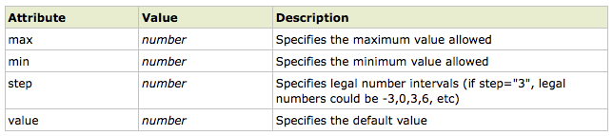
HTML5: Input - number
The number type is used for input fields that should contain a numeric value.
Set restrictions on what numbers are accepted:
Points: <input type="number" name="points" min="1" max="10" />

Slide 16
HTML5: Input - range
The range type is used for input fields that should contain a value from a range of numbers.
The range type is displayed as a slider bar.
You can also set restrictions on what numbers are accepted:
<input type="range" name="points" min="1" max="10" />

Slide 17
HTML5: Input – date pickers
HTML5 has several new input types for selecting date and time:
> date - Selects date, month and year
> month - Selects month and year
> week - Selects week and year
> time - Selects time (hour and minute)‏
> datetime - Selects time, date, month and year. This is now obsolete
> datetime-local - Selects time, date, month and year (local time)‏

Slide 18
HTML5: Input - search
The search type is used for search fields like a site search or Google search.
The search field behaves like a regular text field.

Slide 19
HTML5: Input – color picker
The color type is used for input fields that should contain a color.
This input type will allow you to select a color from a color picker:
Color: <input type="color" name="user_color" />

Slide 20
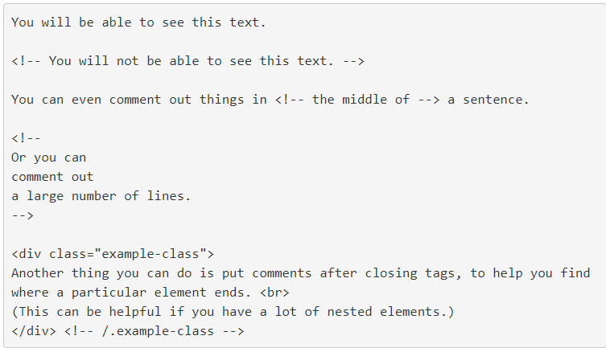
HTML Comments
An HTML comment begins with <!–– and the comment closes with ––>.
HTML comments are visible to anyone that views the page source code, but are not rendered when the HTML document is rendered by a browser.

